Slide 1




CAPSTONE
PROJECT
“Wound Depth Measurement System in Forensic Case”

Slide 2


Research Question
In the field of forensic science, wound depth measurement is a critical point that connects medical analysis with legal investigation

Slide 3
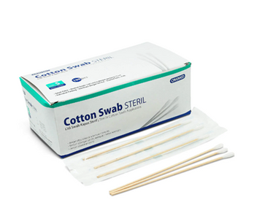
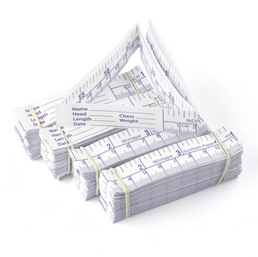

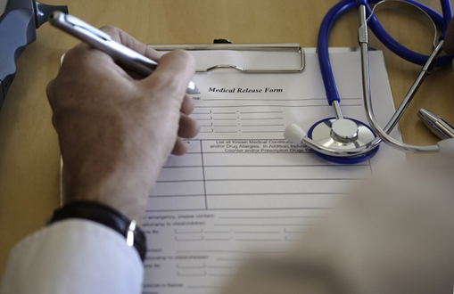
Problem Identification
Currently, the wound measurement process is still conducted manually
Manual Method
Vulnerable to Human Error
Errors in data entry on written documents
Measurement errors
Damaging the wound so that the measurement results do not match the original

Slide 4


Problem Statement
1
How does the wound dimension measurement system work in forensic cases?
What algorithms are used to create a system for measuring wound dimensions in forensic cases, and why is this algorithm used?
2
3
How accurate are the measurements produced by the wound dimension measurement system in forensic cases?

Slide 5



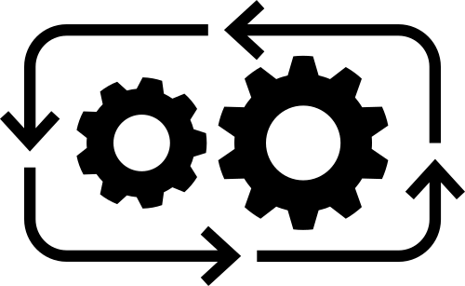


Objective
Developing algorithms for medical devices, specifically for wound measurement tools in forensic cases based on knowledge from previous research
Main Objective
How it Works
Algorithm
Accuracy

Slide 6
Scope of the problem
The system is designed to perform only wound measurements, such as length, width, and depth of the wound
1
2
The system is designed to be used on smartphone
The system is not designed to perform the classification of wound types
3

Slide 7





Engineering Constrain
The measurement results are predictions with an accuracy of over 80%
The system must be user-friendly
The system must be contactless

Slide 8
1
The system is designed to perform measurements in real-time
System Spesification
The measurement results of the system include the length, width, and depth of the wound
2
3
The system operation can be performed on mobile devices (smartphones)
4
The measurement process is contactless
5
The system operation is performed online

Slide 9






Wound Depth Measurement

Slide 10

System Workflow
START
Image Acquisition
Image Segmentation Process
FINISH
Wound Depth Dimension Classification Process using Color Analysis
Measurement Results Data is Displayed and Saved

Slide 11
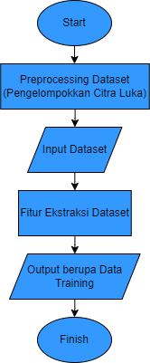

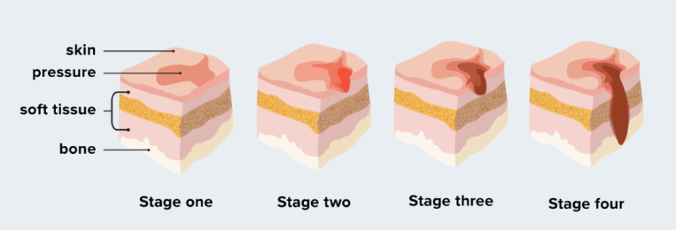
Wound Depth Measurement
Preprocessing Data Training
1
Wound Image Classification According to Its Stage:
Stage II : 36 Images
Stage III: 12 Images
Stage IV: 28 Images

Slide 12
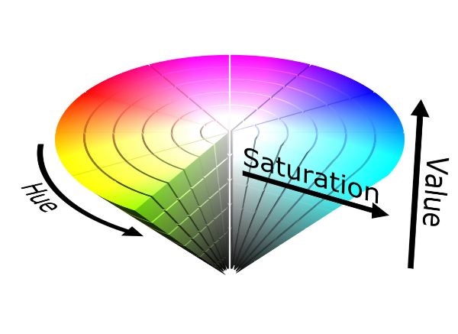
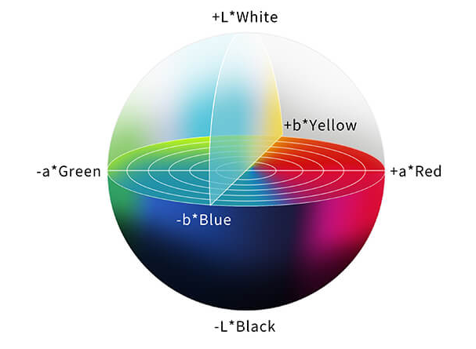
Wound Depth Measurement
Preprocessing Data Training
2
Feature Extraction: HSV and LAB
HSV
LAB

Slide 13

Wound Depth Measurement
Preprocessing Data Training
3
Extracted data is saved as training data in the following formats:
Feature : Hue, Saturation, L, A, dan B
Class : Stage II, Stage III, dan Stage IV

Slide 14
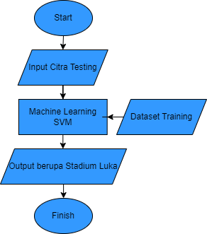
Wound Depth Measurement
Wound Depth Measurement System
1
Image Acquisition (Direct/Indirect)
2
Testing image features are extracted and then input into the Machine Learning SVM
3
Measurement results data is displayed and saved

Slide 15
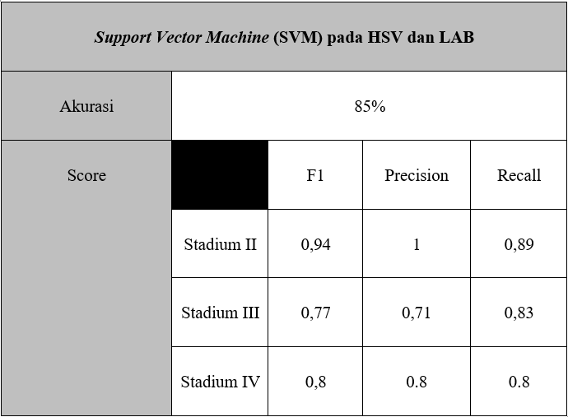
Wound Depth Measurement
Wound Depth Measurement Performance

Slide 16
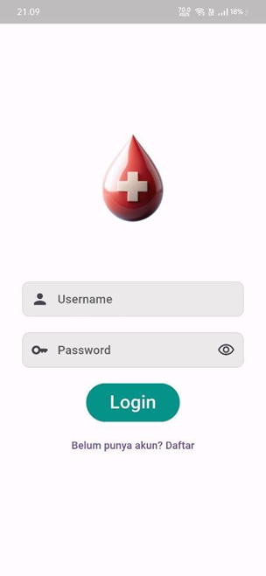
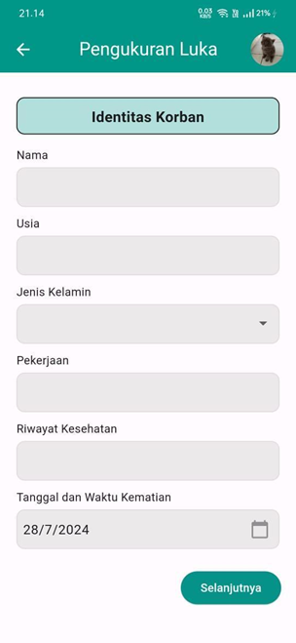
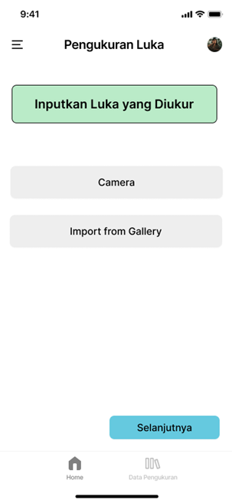
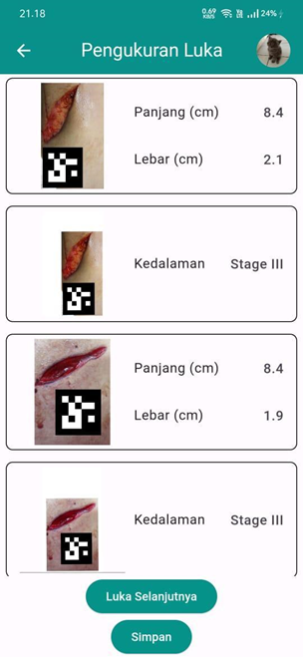
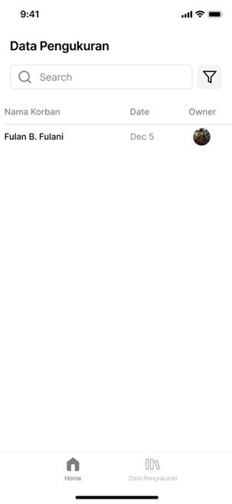
App Interface

Slide 17
Thank you

